Slide 1
Demand
&
Supply

Slide 2
Demand
The market we are going to examine is highly competitive with many competing firms and many consumers.
  This means that firms and consumers are price takers

Slide 3
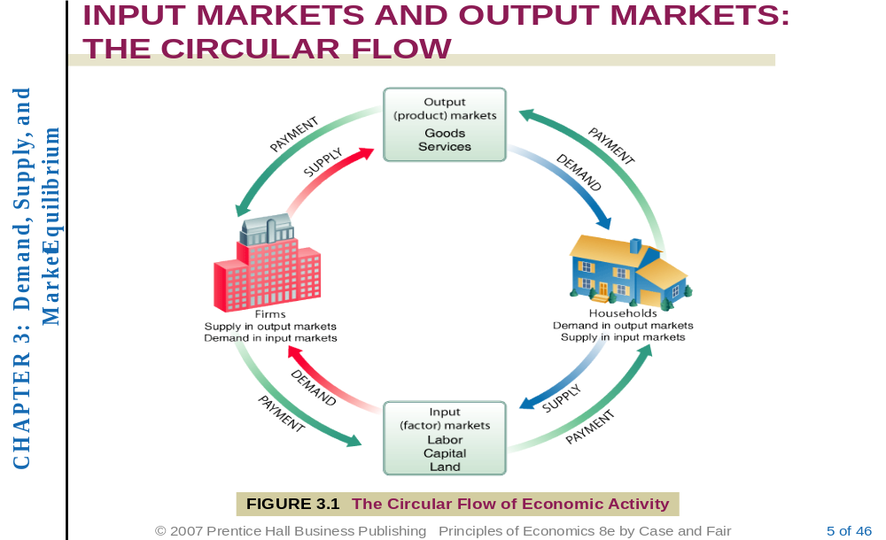
THE CIRCULAR FLOW

Slide 4
Demand
Demand is the quantity of a good or service that consumers are willing and able to buy at various prices in a given period of time.
Though there are several factors that determine a consumer’s decision to buy a commodity, we define demand as a relationship between quantity and price. Price determines the relative value of a commodity and thus the most important determinant of demand

Slide 5
The Law of Demand
The law of demand states that:
There is a an inverse relationship between quantity demanded of a commodity and its price.
Thus:
“Other things unchanged, as price rises, the quantity demanded decreases, and as price falls, the quantity demanded increases”

Slide 6
Exceptions to the law of demand
Generally, the amount demanded of good increases with a decrease in price of the good and vice versa. In some cases, however, this may not be true. Such situations are:
Giffen Goods
Commodities which are used as status symbols

Slide 7
Reasons behind the law of demand
Relationship between demand and price can be explained by:
The Income Effect
The Substitution Effect

Slide 8
Income and Substitution Effects
Income Effect:
When the price of a commodity rises, the consumer would feel poorer as real income falls and thus would buy less and vice versa.

Slide 9
Income and Substitution Effects
Substitution Effect:
When the price of a commodity rises, the good would now cost more than its alternatives or substitutes and thus consumers would switch to the alternatives. The opposite is true for a fall in price

Slide 10
Demand Schedule, Demand Curve and Demand Function
The negative relationship between price and quantity demanded can be presented by a
    demand schedule,
    demand curve and
    demand function.

Slide 11
Demand Schedule
A demand schedule is a table showing how much of a given product a household would be willing to buy at different prices.

Slide 12
Demand Schedule
Price Per Unit | Quantity of Potatoes
20 | 700
40 | 500
60 | 350
80 | 200
100 | 100
120 | 50
140 | 10
160 | 0

Slide 13
Demand Curve
The demand curve is a graph showing the relationship between price of a good and quantity of the good demanded over a given time period.

Slide 14
Demand Curve
According to convention, the demand curve is drawn with price on the vertical axis and quantity on the horizontal axis.
A demand curve shows the relationship between price and quantity demanded only; all (other) factors affecting demand are assumed to remain unchanged along a demand curve.

Slide 15
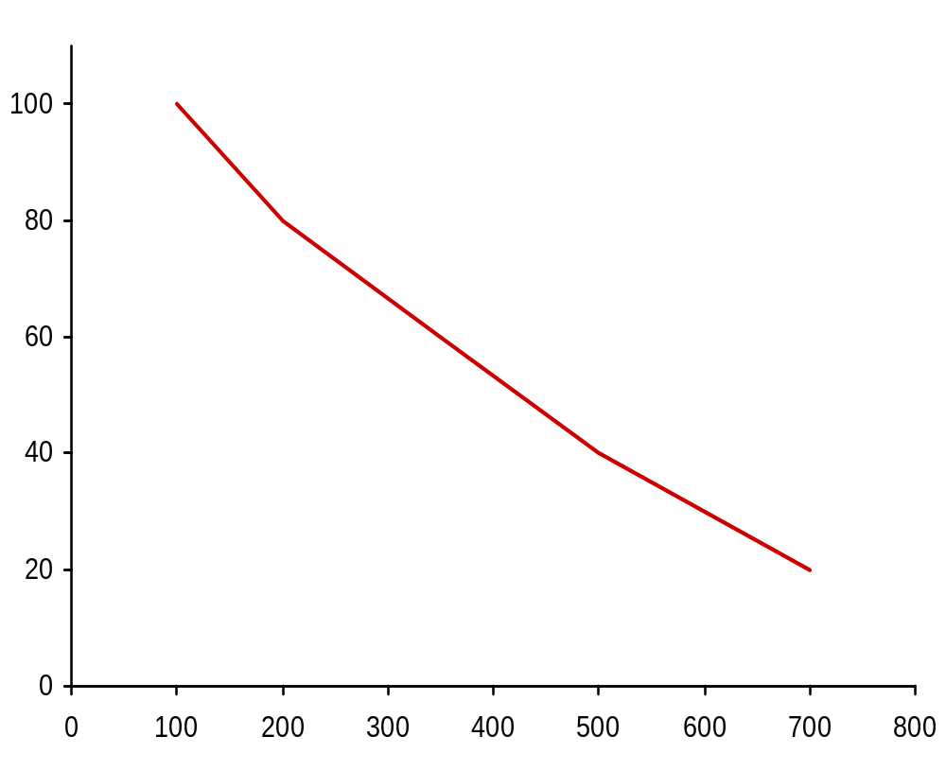

Demand Curve for potatoes (monthly)
E
Point
Price
(pence per kg)
20
40
60
80
100
Market demand
(tonnes 000s)
700
500
350
200
100
A
B
C
D
E
D
C
Price (pence per kg)
B
A
Demand
Quantity (tonnes: 000s)

Slide 16
Three Properties of the Demand Curve
First, the demand curve is negatively sloped which reflects the law of demand. An increase in price is likely to lead to a decrease in quantity demanded, and a decrease in price is likely to lead to an increase in quantity demanded.

Slide 17
Three Properties of the Demand Curve
  They intersect the price (Y) axis, a result of limited incomes and wealth. That is As long as households have limited incomes and wealth, all demand curves will intersect the price axis.
    For any commodity, there is always a price above which a household will not or cannot pay. Even if the good or service is very important, all households are ultimately constrained, or limited, by income and wealth.

Slide 18
Three Properties of the Demand Curve
  The third property is that demand curves intersect the quantity axis is a matter of common sense. Demand in a given period of time is limited, if only by time, even at a zero price. In other words They intersect the quantity (X-) axis, a result of time limitations and diminishing marginal utility.

Slide 19
The Demand Function
  simple demand functions
  Qd = a – bP
  more complex demand functions
  Qd = a – bP + cY + dPs – ePc
  could be linear or non-linear functions

Slide 20
VODA
51040223692325
48292051068819
46549741801430
54463197400834

Slide 21
Other determinants of demand
  tastes
  number and price of related goods
  income
  distribution of income
  expectations

Slide 22
Changes in Demand versus Changes in Quantity Demanded
A change in price, ceteris paribus, results in a change in quantity demanded; that is a movement along the curve.
A change in demand (curve) results from changes in factors other than price. Such changes cause shifts of the demand curve.

Slide 23
Factors causing changes (shifts) in demand (curve):
Changes in income
Taste
prices of related goods (substitutes or complementary goods)
expectations about future prices,
number of buyers
Other non-self-price factors

Slide 24
Change in Quantity Demanded
P
A
20
B
10
100
200
Q

Slide 25
An increase in demand
  Possible causes of a rise in demand
  Tastes shift towards this product
  Rise in price of substitute goods
  Fall in price of complementary goods
  Rise in income
  Expectations of a rise in price
P
Price
D₀
D₁
O
Q₀
Q₁
Quantity

Slide 26
A Decrease in demand
  Possible causes of a fall in demand
  Tastes shift against this product
  Fall in price of substitute goods
  Rise in price of complementary goods
  Fall in income
  Expectations of a fall in price
P
Price
D₁
D₀
O
Q₀
Q₁
Quantity

Slide 27
Which way will the market demand for petrol shift if the price of cars rises?
Q
Right
Left
No shift (movement along the curve)

Slide 28
Which way will the market demand for petrol shift if petrol becomes more expensive
Q
Right
Left
No shift (movement along the curve)

Slide 29
The effect on the margarine market of a reduction in butter prices would be to:
Q
increase the price of margarine by an identical amount.
leave the demand for margarine unaffected.
decrease the demand for margarine at all prices.
increase the demand for margarine at all prices.
shift the supply of margarine to the left.

Slide 30
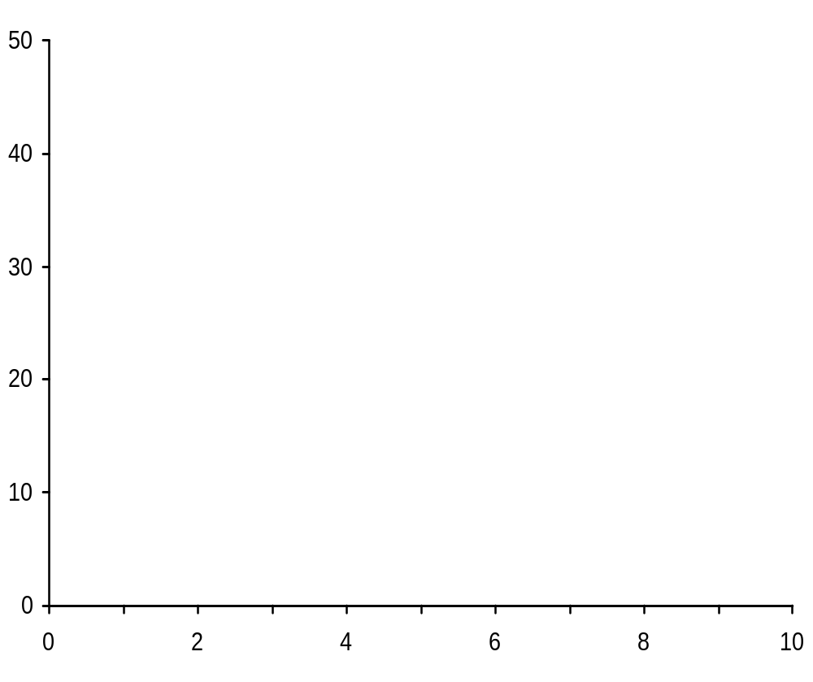
Demand curve for equation: Q_{d} = 10 000 – 200P
P
D
Q (000s)

Slide 31
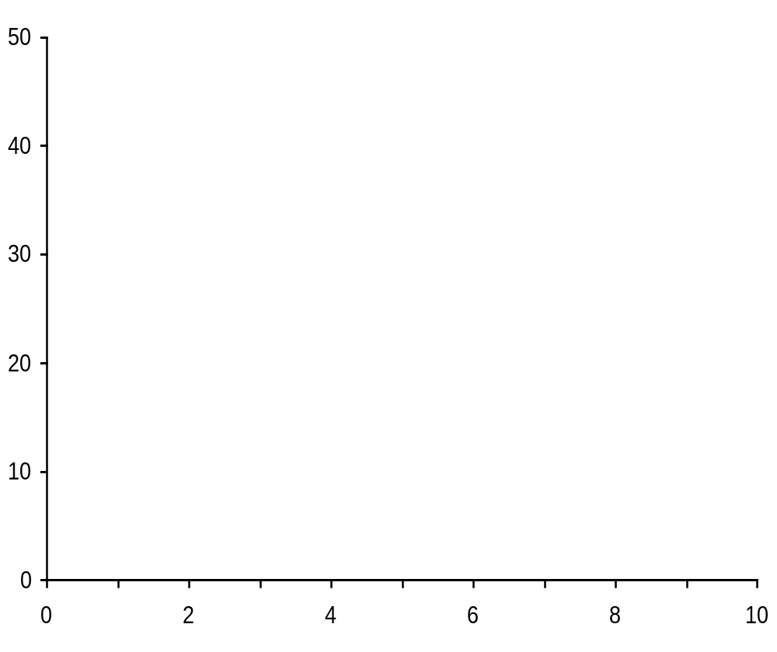
Demand curve for equation: Q_{d} = 10 000 – 200P
P
5
Q_{d} (000s)
9
P
D
Q (000s)

Slide 32
Demand curve for equation: Q_{d} = 10 000 – 200P
P
5
10
Q_{d} (000s)
9
8
P
D
Q (000s)

Slide 33
Demand curve for equation: Q_{d} = 10 000 – 200P
P
5
10
15
Q_{d} (000s)
9
8
7
P
D
Q (000s)

Slide 34
Demand curve for equation: Q_{d} = 10 000 – 200P
P
5
10
15
20
Q_{d} (000s)
9
8
7
6
P
D
Q (000s)

Slide 35
Market Demand Verses Individual Demand
Market demand: Sum of individual Demands for the particular good

Slide 36
Market Demand
Market demand is the sum of all the quantities of a good or service demanded per period by all the households buying in the market for that good or service.
It is obtained by adding up all the quantity demanded by each of the household at each price level.

Slide 37
Price | Qty by A | Qty by B | Qty by C | Market Demand
2 | 5 | 6 | 14 | 25
4 | 4 | 4 | 10 | 18
6 | 2 | 3 | 7 | 12
8 | 1 | 2 | 5 | 8
10 | 0 | 1 | 4 | 5

Slide 38
Supply
Definition: Supply is the amount of a particular product that a firm would be willing and able to offer for sale at a particular price during a given time period.

Slide 39
The law of Supply
The law of supply postulates a positive relationship between price and quantity of a good supplied:
It States that: “An increase in market price will lead to an increase in quantity supplied, and a decrease in market price will lead to a decrease in quantity supplied, all other things being equal”.

Slide 40
Reasons Behind the Law of Supply
As firms increase production beyond a point, the production cost rises more rapidly and thus firms would only increase production and supply if they can get higher price for the commodity.
Higher prices make the production of a commodity more profitable. This means that as price rises, firms would produce more to take advantage of the higher price to increase profits.

Slide 41
Reasons Behind the Law of Supply
Increase in price encourage new entrants into the market to take advantage of higher potential profits thereby increasing market supply.

Slide 42
Supply Schedule, Supply Curve, and Supply Function
The relationship between price and quantity supplied of a commodity can be expressed in three way. These are: supply Schedule, Supply Curve, and Supply Function

Slide 43
Supply Schedule
Supply schedule is a table which shows how much one or more firms will be willing to supply at particular prices.
The supply schedule shows in tabular form the quantity of goods that a supplier would be willing and able to sell at specific prices under the existing circumstances.

Slide 44
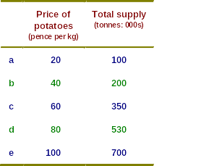

Slide 45
Supply Curve
The supply curve is a graph that shows the amount of some good that producers are willing and able to sell at various prices, assuming all determinants of supply other than the price of the good in question, remain the same.
The supply curve usually slopes upward, since higher prices give producers an incentive to supply more in the hope of making greater revenue.

Slide 46
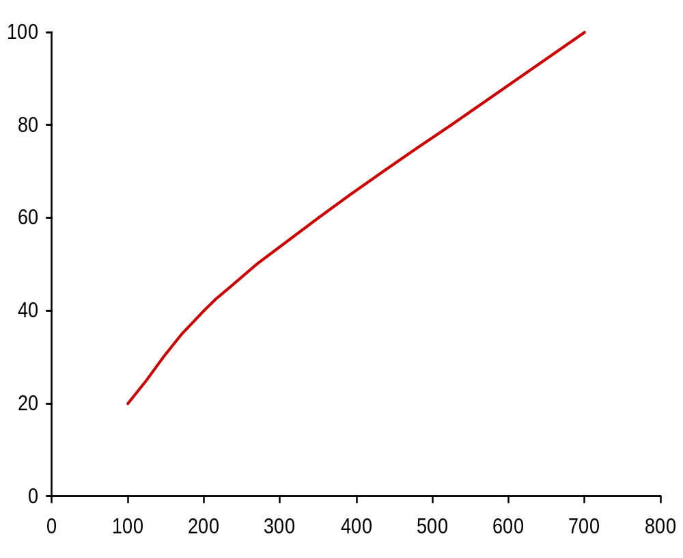
Market supply of potatoes (monthly)
Supply
P
20
Q
100
a
Price (pence per kg)
a
Quantity (tonnes: 000s)

Slide 47
Market supply of potatoes (monthly)
Supply
P
20
40
Q
100
200
a
b
Price (pence per kg)
b
a
Quantity (tonnes: 000s)

Slide 48
Market supply of potatoes (monthly)
Supply
P
20
40
60
Q
100
200
350
a
b
c
c
Price (pence per kg)
b
a
Quantity (tonnes: 000s)

Slide 49
Market supply of potatoes (monthly)
Supply
d
P
20
40
60
80
Q
100
200
350
530
a
b
c
d
c
Price (pence per kg)
b
a
Quantity (tonnes: 000s)

Slide 50
Market supply of potatoes (monthly)
e
Supply
d
P
20
40
60
80
100
Q
100
200
350
530
700
a
b
c
d
e
c
Price (pence per kg)
b
a
Quantity (tonnes: 000s)

Slide 51
Supply Function
The mathematical expression of the relationship between quantity of a good that firms are willing to sell and the price level.
  simple supply functions
    Q_{s} = a + bP
  more complex supply functions
    Q_{s} = a + bP + cC + dP_{s} – eP_{j}

Slide 52
Other determinants of supply
  costs of production
  profitability of alternative products (substitutes in supply)
  profitability of goods in joint supply
  nature and other random shocks
  aims of producers
  expectations of producers

Slide 53
Change in Quantity Supplied vs. Change in Supply
Change in quantity supplied – is a movement along the same supply curve, due solely to a change in price, i.e., all other factors held constant.
Change in supply – is a shift in the entire supply curve (either to the left or to the right) as a result of changes in other factors affecting supply.

Slide 54
Shifts in the supply curve
P
  Possible causes of a rise in supply
  Fall in costs of production
  Reduced profitability of alternative products that could be supplied
  Increased profitability of goods in joint supply
  Benign shocks
  Expectations of a fall in price
S₀
S₁
Increase
O
Q

Slide 55
Shifts in the supply curve
P
S₂
S₀
S₁
Decrease
Increase
O
Q

Slide 56
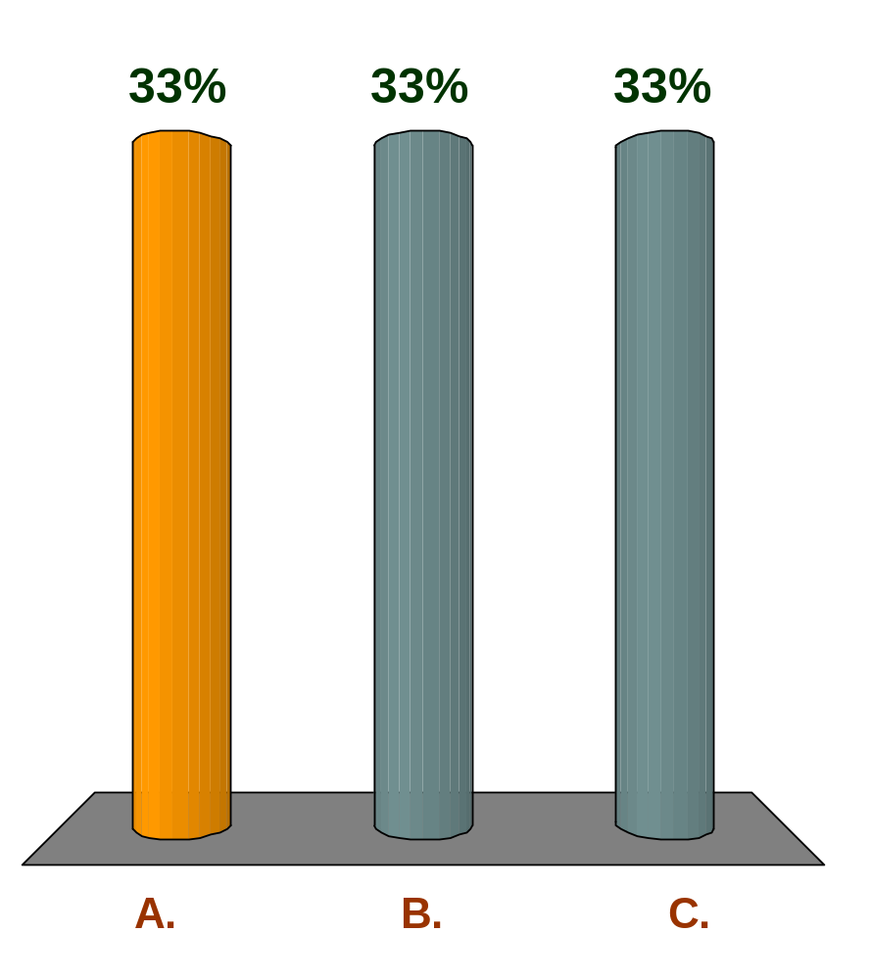
Which way will the market supply of bread shift if the price of flour falls?
Q
Right
Left
No shift (movement along the curve)

Slide 57
Supply and Demand
  Price and output determination

Slide 58
Market Equilibrium
Market equilibrium is that state in which the quantity that firms want to supply equals the quantity that consumers want to buy.
The price that clears the market is called the equilibrium price and the quantity (sold and bought) is called the equilibrium quantity.

Slide 59
Market for Fufu
Price Per Plate | Quantity Demanded | Quantity Supplied
0 | 8 | 0
0.50 | 7 | 1
1.00 | 6 | 2
1.50 | 5 | 3
2.00 | 4 | 4
2.50 | 3 | 5
3.00 | 2 | 6
3.50 | 1 | 7
4.00 | 0 | 8

Slide 60
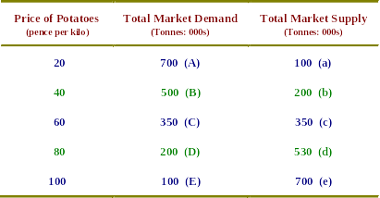
Equilibrium price and output:

Slide 61
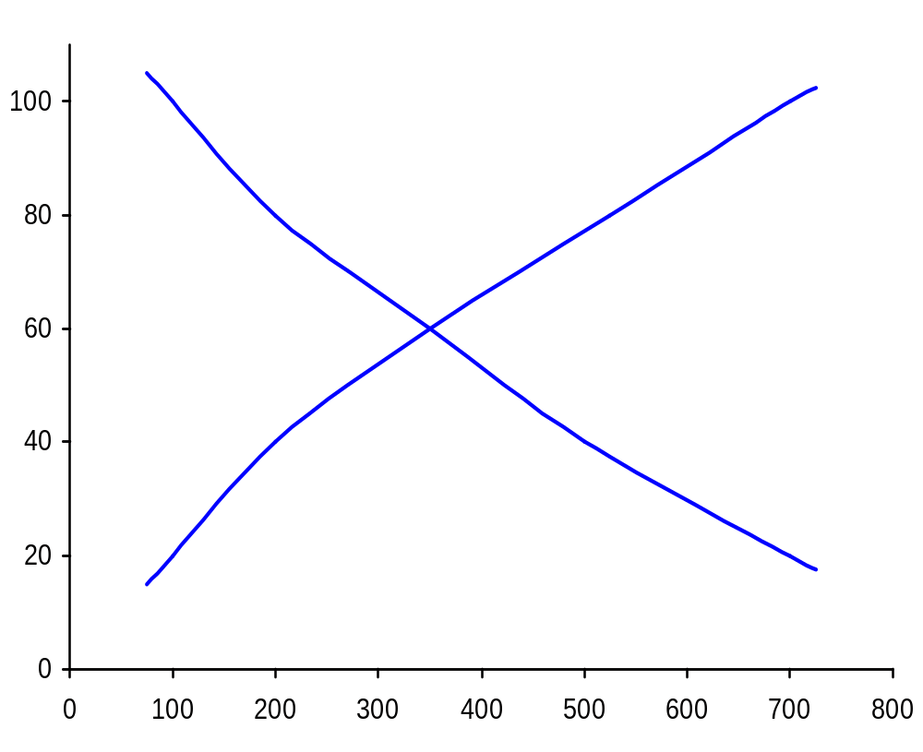
The determination of market equilibrium
(potatoes: monthly)
E
e
Supply
D
d
C
c
Price (pence per kg)
b
B
a
A
Demand
Quantity (tonnes: 000s)

Slide 62
The determination of market equilibrium
(potatoes: monthly)
E
e
Supply
D
d
C
c
Price (pence per kg)
b
SHORTAGE
B
(300 000)
a
A
Demand
Quantity (tonnes: 000s)

Slide 63
The determination of market equilibrium
(potatoes: monthly)
E
e
Supply
D
SURPLUS
d
(330 000)
C
c
Price (pence per kg)
b
B
a
A
Demand
Quantity (tonnes: 000s)

Slide 64
The determination of market equilibrium
(potatoes: monthly)
E
e
Supply
D
d
Price (pence per kg)
b
B
a
A
Demand
Q_{e}
Quantity (tonnes: 000s)

Slide 66
Changes In Equilibrium
When supply and demand curves shift, the equilibrium price and quantity change.

Slide 67
Changes in Deamand
If any of the determinants of demand changes (other than price), the whole of the demand curve shifts.
This will mean a movement along the supply curve and the new demand curve.

Slide 68
Effect of an increase in demand
P
S
Initial equilibrium at point g
g
P_{e1}
D₁
O
Q_{e1}
Q

Slide 69
Effect of an increase in demand
P
S
g
P_{e1}
D₁
O
Q_{e1}
Q

Slide 70
Effect of an increase in demand
P
S
g
P_{e1}
D₂
D₁
O
Q_{e1}
Q

Slide 71
Effect of an increase in demand
P
S
i
New equilibrium at point i
P_{e2}
g
h
P_{e1}
D₂
D₁
O
Q_{e1}
Q_{e2}
Q

Slide 72
Price and output determination
Notes:
7

Slide 73
Effects of shifts in the supply curve
Just like the demand , if there is a change in the determinants of supply (other than price) the whole supply curve shifts.
This causes movement along demand curve and new supply curve.
Assume that there is increase in taxes, this will cause a decrease in supply as shown below:

Slide 74
Effect of a shift in the supply curve
P
S₁
g
Initial equilibrium at point g
P_{e1}
D
O
Q_{e1}
Q

Slide 75
Effect of a shift in the supply curve
P
S₁
g
P_{e1}
D
O
Q_{e1}
Q

Slide 76
Effect of a shift in the supply curve
P
S₂
S₁
g
P_{e1}
D
O
Q_{e1}
Q

Slide 77
Effect of a shift in the supply curve
P
S₂
S₁
k
P_{e3}
j
g
New equilibrium at point k
P_{e1}
D
O
Q_{e3}
Q_{e1}
Q

Slide 78
Change in both demand and supply
Here we observe a simultaneous change in both demand and supply
The relative magnitudes of change in supply and demand determine the outcome of market equilibrium.

Slide 79
Change in both demand and supply
Let us assume that there is an increase in demand and a decrease in supply
Let us say Government increases the salaries of Teachers and Teachers are important consumers of Yam. At the say time, bad rainfall pattern decreases the amount of yam supplied.

Slide 80



Increase in Demand And a Decrease in Supply
P
S4
S3
S2
S1
P_{e1}
e1
D₂
D₁
O
Q_{e1}
Q

Slide 81
Increase in both Demand And Supply
P
S0
S1
e4
e1
e3
P_{e1}
e2
D₄
D₃
D₂
D₁
O
Q_{e1}
Q
The relative magnitudes of increase in supply and demand determine the outcome of market equilibrium.

Slide 82
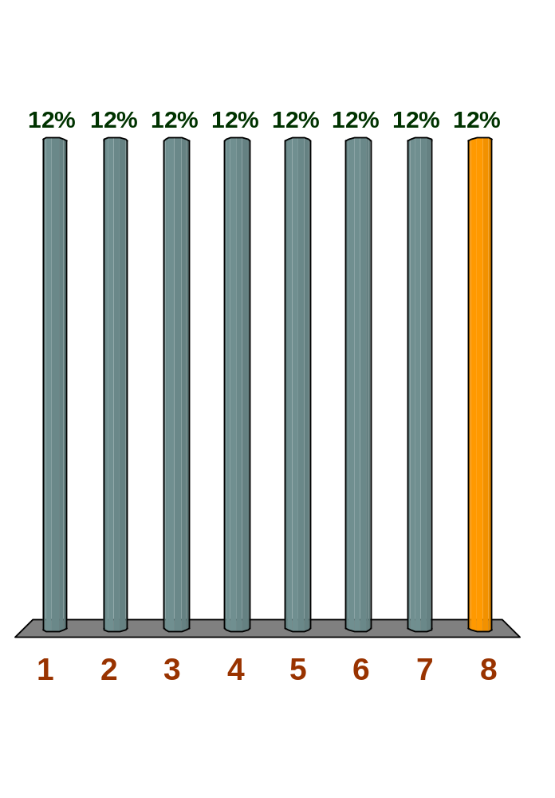
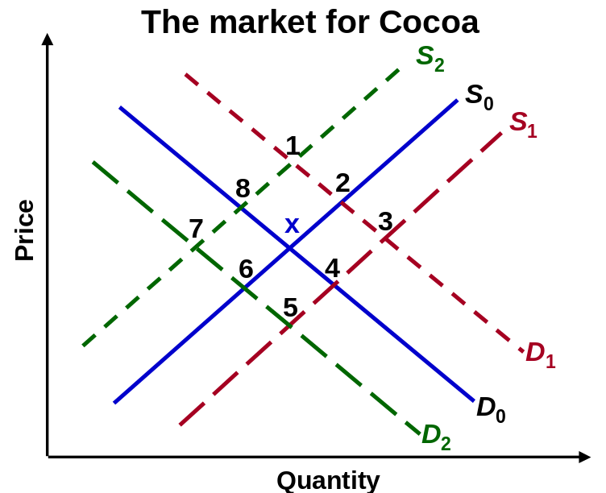
Q The diagram shows the market for cocoa. Equilibrium is currently at point x. To which equilibrium point
(1, 2, 3, 4, 5, 6, 7 or 8) will the market move if there is a rise in the cost of producing cocoa?

Slide 83
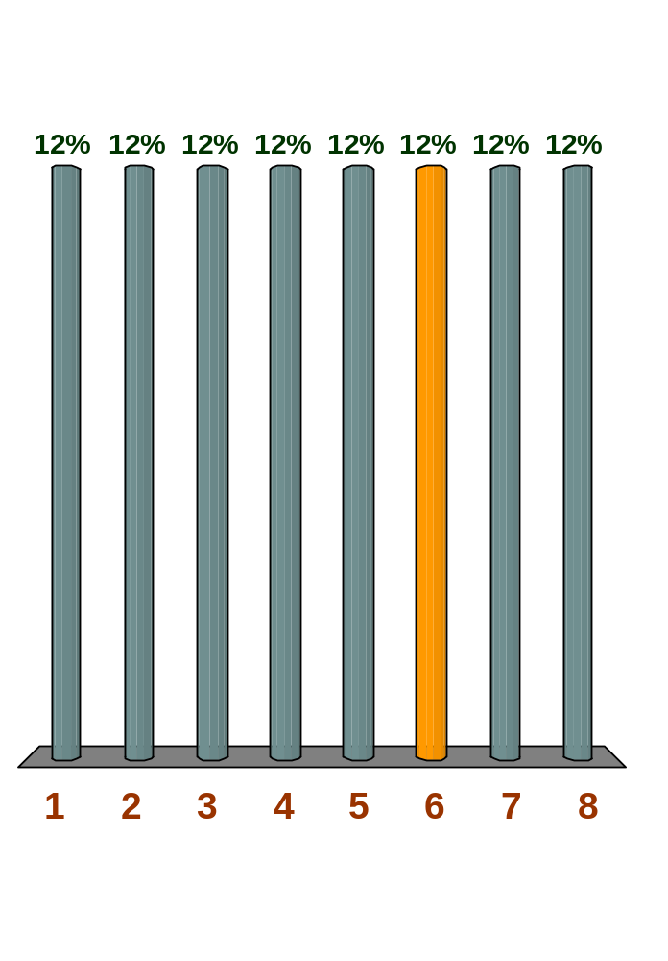
Q The diagram shows the market for cocoa. Equilibrium is currently at point x. To which equilibrium point
(1, 2, 3, 4, 5, 6, 7 or 8) will the market move if there is a rise in wages in the chocolate industry?

Slide 84
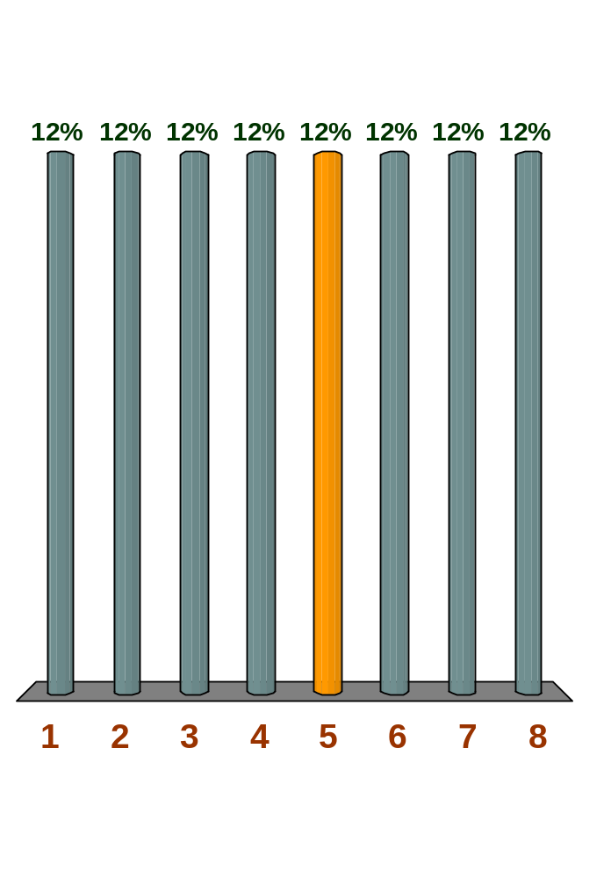
Q The diagram shows the market for cocoa. Equilibrium is currently at point x. To which equilibrium point
(1, 2, 3, 4, 5, 6, 7 or 8) will the market move if there is speculation that the price of cocoa will fall?

Slide 85
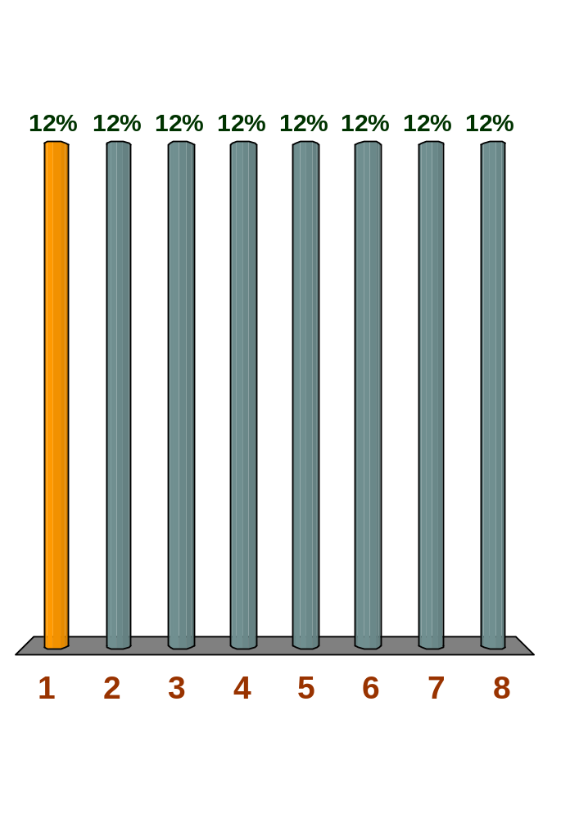
Q The diagram shows the market for cocoa. Equilibrium is currently at point x. To which equilibrium point (1, 2, 3, 4, 5, 6, 7 or 8) will the market move if there is increased demand for chocolate and a new tax on cocoa?

Slide 86
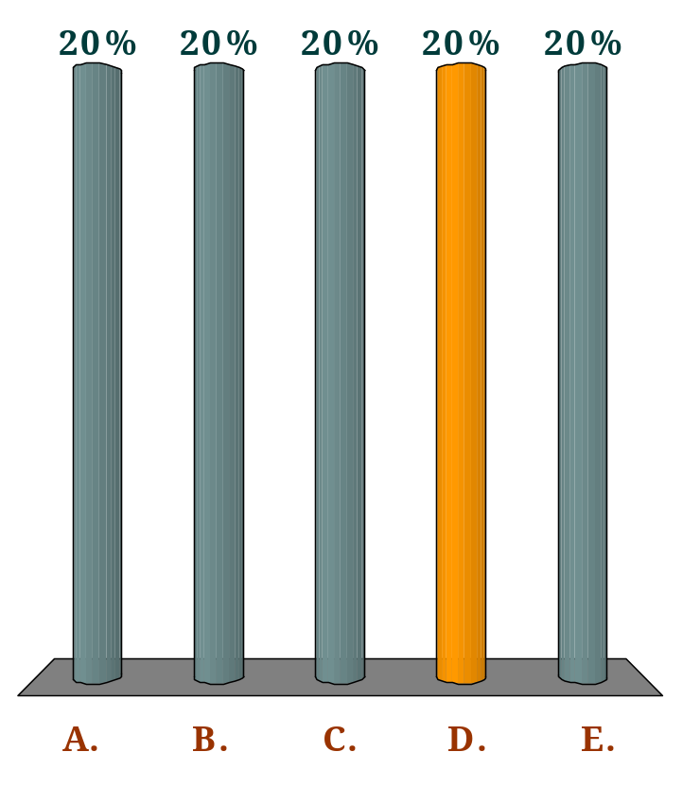
If it is observed that the price and quantity of a product sold both fall, we can conclude that:
Q
demand has shifted to the right, but we cannot draw any conclusions about supply without more information.
demand has shifted to the left, but we cannot draw any conclusions about supply without more information.
supply has shifted to the right, but we cannot draw any conclusions about demand without more information.
supply has shifted to the left, but we cannot draw any conclusions about demand without more information.
We cannot draw any conclusions about shifts in either curve without more information.

Slide 87
The Control of Prices
The free working of the market will always establish equilibrium price and quantity.
At the equilibrium, there will be no shortage or surplus.

Slide 88
The Control of Prices
However, the equilibrium price and quantity may not be the most desirable. Government may therefore enter the market and fix a price that may be above or below the equilibrium price.
There are two kinds:
Minimum Price control, or Price Floor
Maximum Price control, or price ceiling

Slide 89
Minimum Price Control
Minimum Price or price Floor establishes a minimum legal price below which the commodity cannot be sold.
When a minimum price is established, it means that the price is not allowed to fall below that level.
Example: Minimum wage

Slide 90
Reasons for Minimum Price Control
To protect producers income
To create surplus in periods of excess production which can be stored in preparation for future shortages
To protect workers income in the case of minimum wage

Slide 91
Minimum price: price floor
P
S
P_{e}
D
O
Q

Slide 92
Minimum price: price floor
P
S
surplus
minimum
price
P_{e}
D
O
Q_{d}
Q_{s}
Q

Slide 93
Dealing with resulting surpluses
Government could buy the surplus and sell it later or sell it abroad
Supply could be artificially lowered by government restrictions
Demand could be raised by advertisement, finding alternative uses, or by reducing consumption especially imports

Slide 94
Maximum Price Control
A price ceiling establishes a maximum price that sellers are legally permitted to charge.
Sellers are not allowed to sell above the maximum price
Example: Rent, Fuel prices in Ghana
Maximum prices are set to protect consumers especially for essential commodities.

Slide 95
Maximum price: price ceiling
P
S
P_{e}
D
O
Q

Slide 96
Maximum price: price ceiling
P
S
P_{e}
maximum
price
shortage
D
O
Q_{s}
Q_{d}
Q

Slide 97
Effects of Maximum Price Control
Shortage
Underground markets (Parallel or Black Market).
Quantity produced may fall worsening the shortage

Slide 98
Dealing with the Shortages
Government can encourage supply
Direct production by government
Discourage demand
Encourage production of alternative goods
Controlling people’s income

Slide 99
Effect of price control on underground-market prices
P
S
No underground market
P_{e}
Price ceiling
P_{g}
D
O
Q_{s}
Q_{d}
Q

Slide 100

Effect of price control on underground-market prices
P
S
P_{b}
If operators in underground markets buy all the supplies at P_{g}, the black market equilibrium price will be P_{b}.
P_{e}
P_{g}
D
O
Q_{s}
Q_{d}
Q

Slide 101
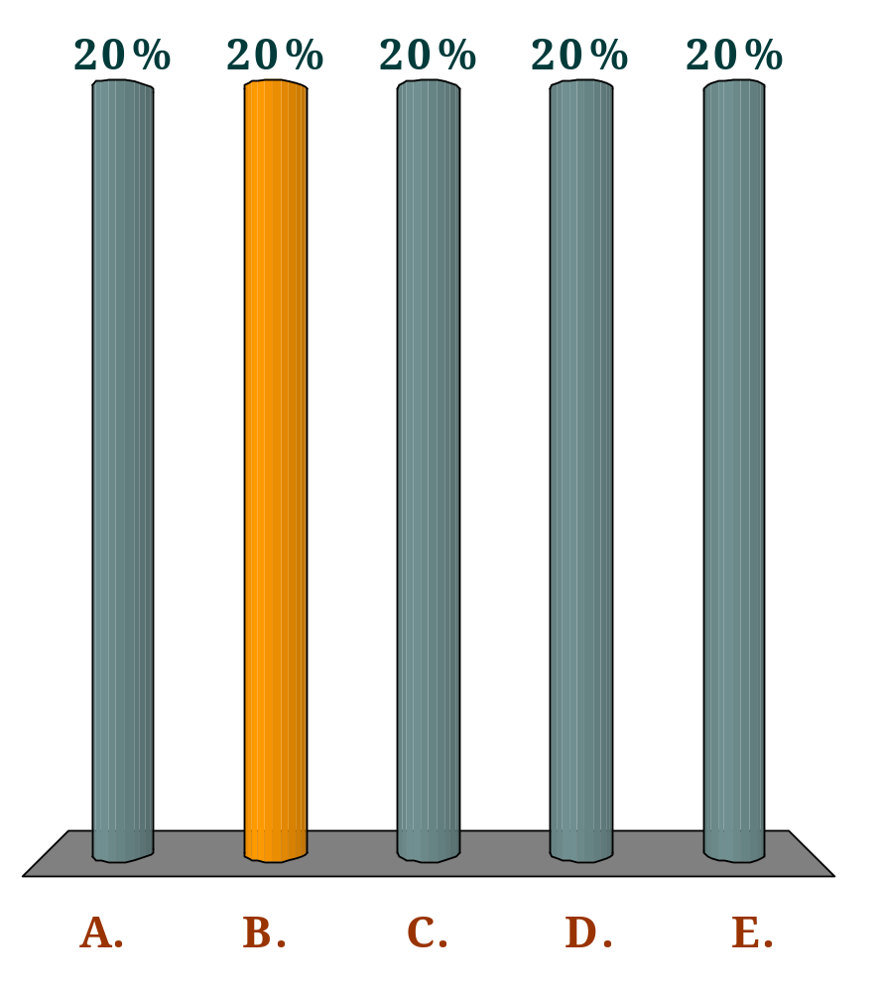
Which one of the following controls would involve setting a minimum price rather than a maximum price of a good (or factor)?
Q
Controls on rents to protect tenants on low incomes.
Controls on wages to protect workers on low incomes.
Controls on basic food prices to protect consumers on low incomes.
Controls on transport fares to protect passengers on low incomes.
None of the above.

Slide 102

If the government raises the minimum wage (relative to other wage rates):
Q
unemployment would fall.
wage rates in higher-paid jobs would fall.
the demand for workers at the minimum wage would rise.
the supply of workers at the minimum wage would rise.
there would be a smaller disequilibrium at the minimum wage than before.

Slide 103
Question:
The market for text books is currently in equilibrium. The following are some changes that may take place in the market for textbooks. For each of the following, indicate what will happen to either the demand for or the supply of textbooks by listing which curve is affected and then the terms: "shift right or "shift left" and show it graphically. (NOTE: START FROM THE INITIAL EQUILIBRIUM)

Slide 104
Question (Con’t)
An increase in student enrolment at universities across the country
A decrease in the price of ink used to print textbooks
A drop in income (textbooks are a normal good).
An improvement in the technology used to print textbooks

Slide 105
LECTURE TWO ENDS

